Slide 1
VOICE CONTROLLED CAR
GOVIND KUMAR
ENTRY NO-17bCS022
DOCSE
GUIDED BY-AJAY KAUL SIR

Slide 2
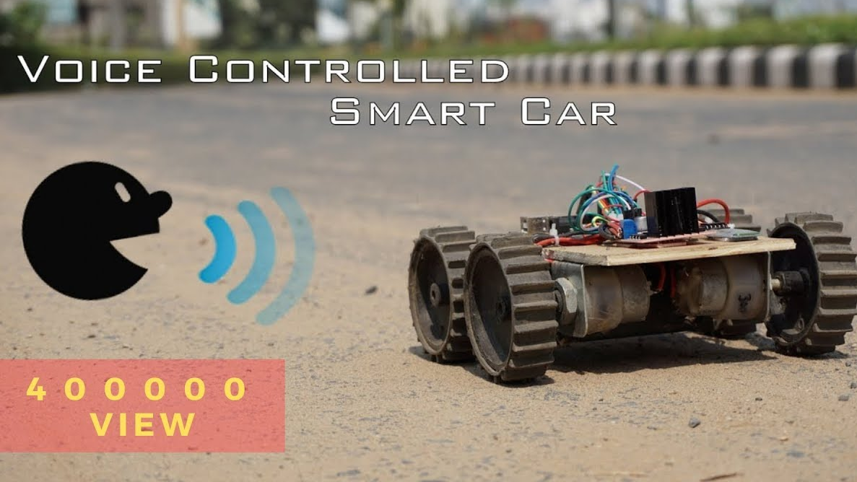


Slide 3

“Think about a creating a car which would be controlled by your voice”

Slide 4
DESCRIPTION
The concept was based on was voice recognition technology.
The person interacts with the car by shouting out commands like "faster", "slower", "right", "left", and "stop". The person will be able to feel like they are in full control of the car by doing this, thus giving them the sense of being important. The programs their own voice into the receiver so that only they can operate the car.

Slide 5
MATERIAL REQUIRED
PLYWOOD
4 CLAMPS
250 rpm DC MOTORS
L298N Dual Motor Controller
HC 05 Bluetooth Module
Arduino Uno
Wires
Plastic Tyres

Slide 6
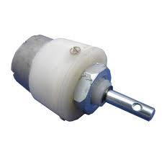
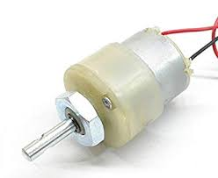
DC Motor
•10 to 250 RPM 12V DC motors with- Gearbox
• 6 mm shaft diameter with internal hole
• No - Load Current = 60 mA(max)
• Load Current = 300 mA(max)

Slide 7
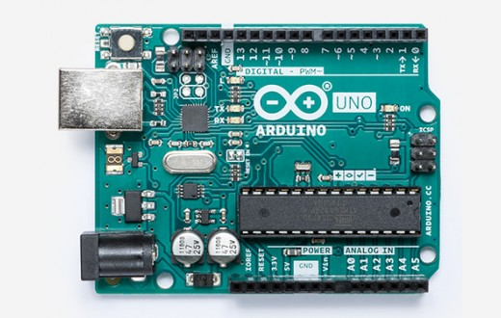
Arduino Uno
The Arduino UNO is an open-source microcontroller board based on the Microchip ATmega328P microcontroller and developed by Arduino.cc.^{[2][3]} The board is equipped with sets of digital and analog input/output (I/O) pins that may be interfaced to various expansion boards (shields) and other circuits.The board has 14 Digital pins, 6 Analog pins, and programmable with the Arduino IDE (Integrated Development Environment) via a type B USB cable.^{[4]} It can be powered by a USB cable or by an external 9 volt battery, though it accepts voltages between 7 and 20 volts.

Slide 8
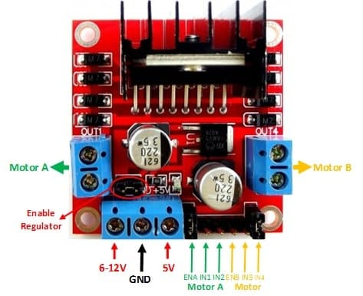
L298N Dual Motor Controller
The L298 is an integrated monolithic circuit in a 15-
lead Multiwatt and PowerSO20 packages. It is a
high voltage, high current dual full-bridge driver de-
signed to accept standard TTL logic levels and drive
inductive loads such as relays, solenoids, DC and
stepping motors. Two enable inputs are provided to
enable or disable the device independently of the in-
put signals.

Slide 9
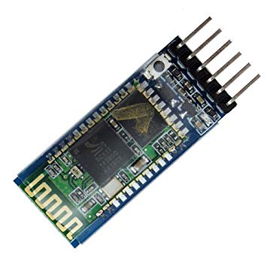
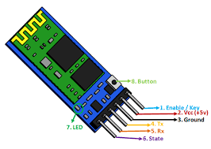
HC - 05 BLUETOOTH MODULE
The HC-05 is a very cool module which can add two-way (full-duplex) wireless functionality to your projects. You can use this module to communicate between two microcontrollers like Arduino or communicate with any device with Bluetooth functionality like a Phone or Laptop. There are many android applications that are already available which makes this process a lot easier. The module communicates with the help of USART at 9600 baud rate hence it is easy to interface with any microcontroller that supports USART. We can also configure the default values of the module by using the command mode. So if you looking for a Wireless module that could transfer data from your computer or mobile phone to microcontroller or vice versa then this module might be the right choice for you.

Slide 10
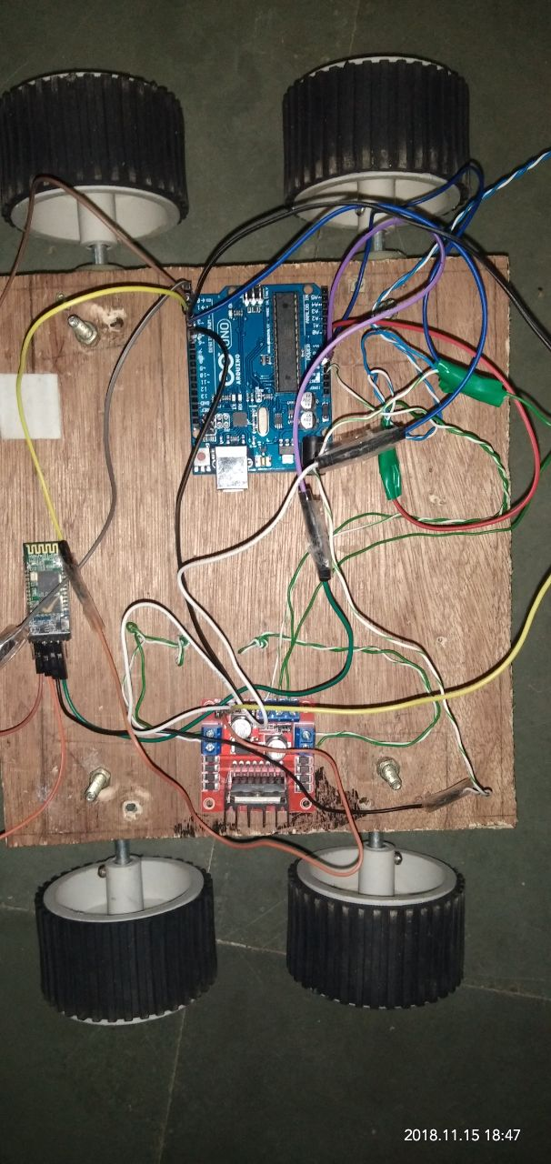

Slide 11
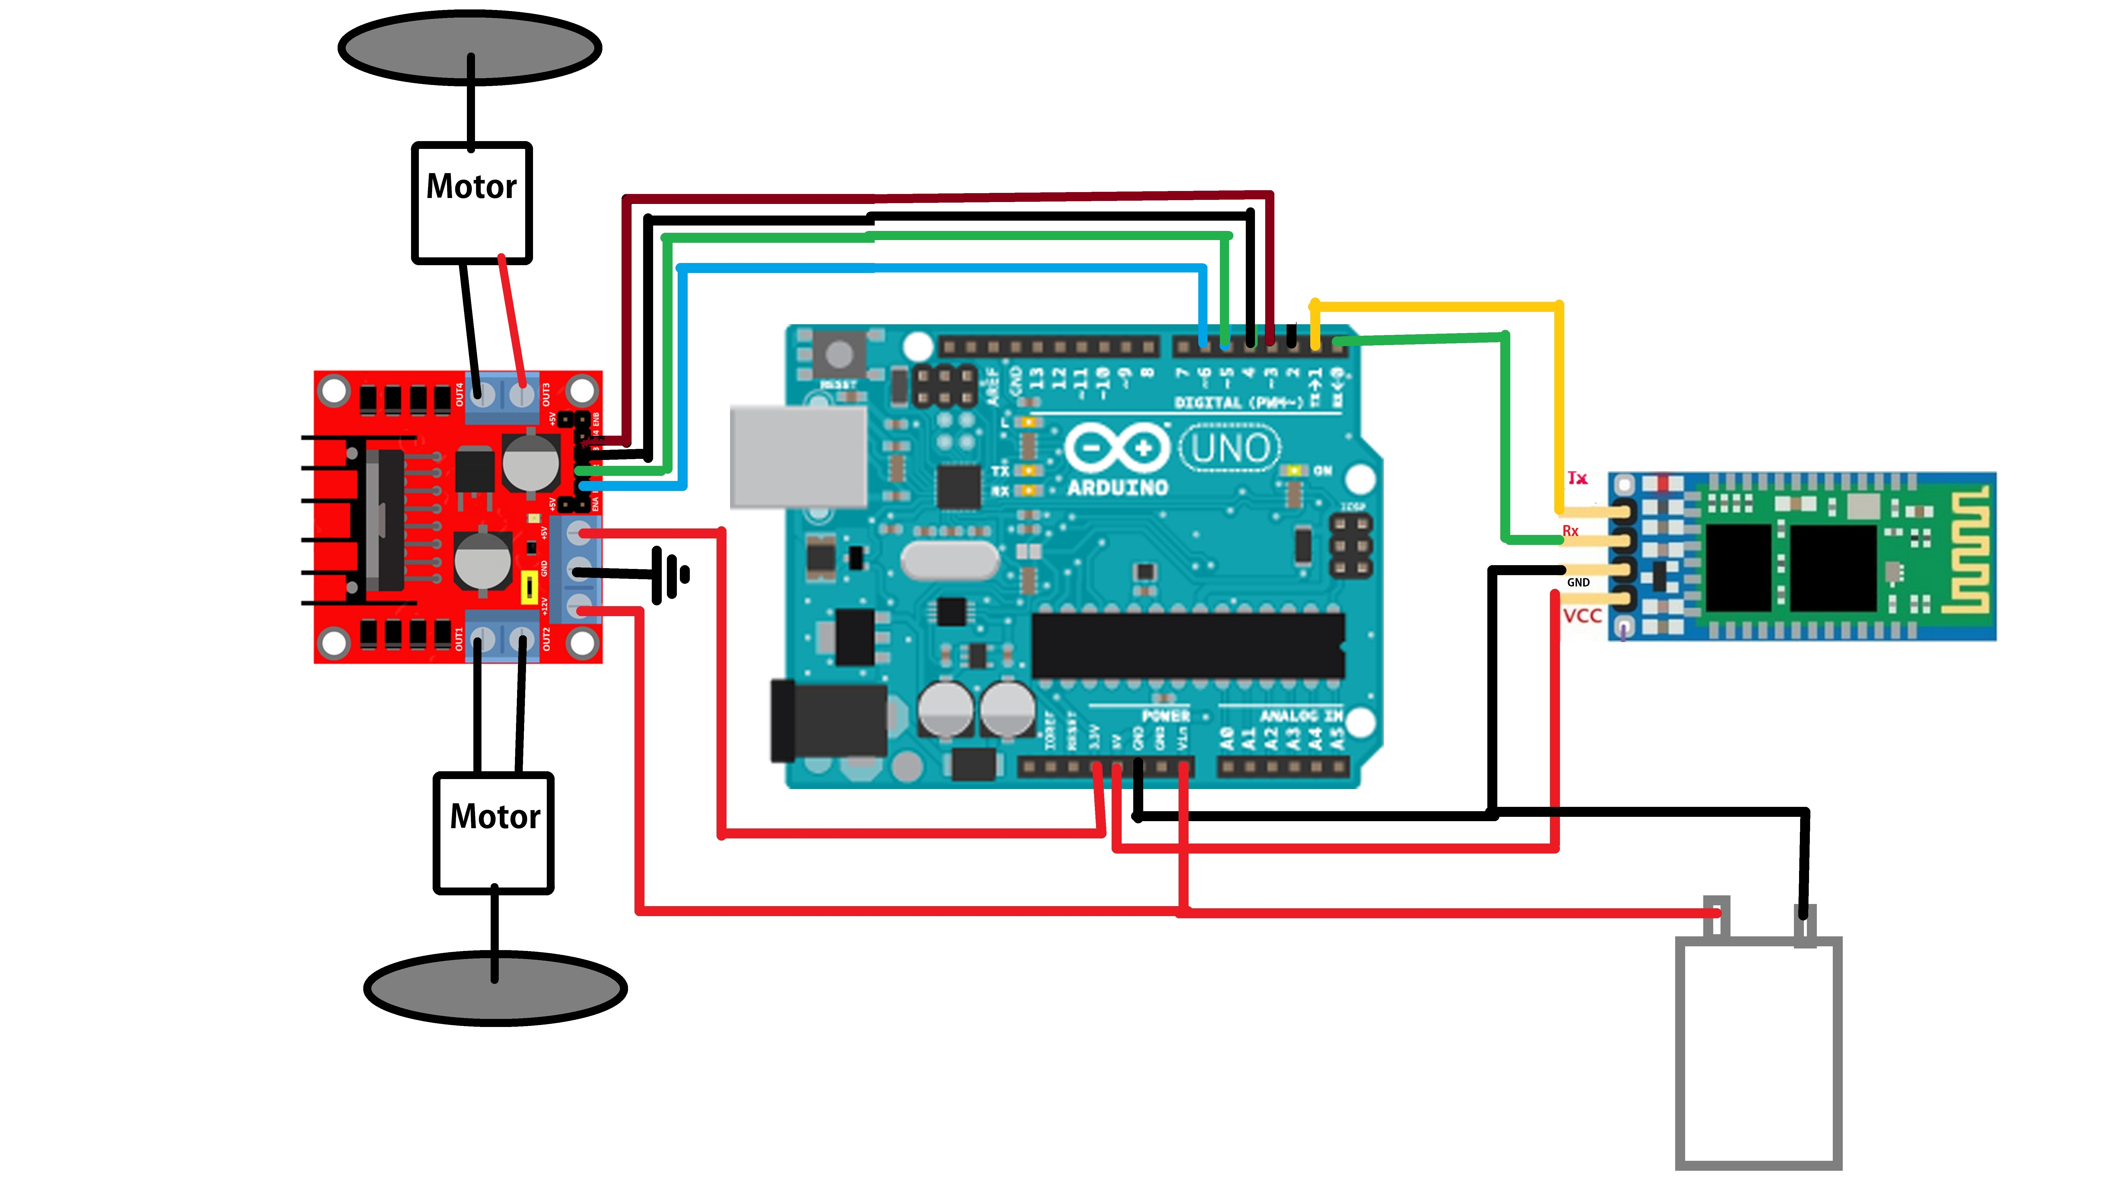

Slide 12
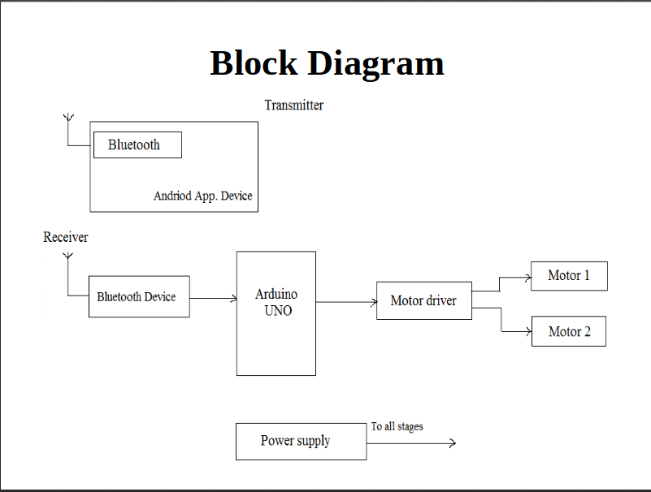

Slide 13
PROGRAM
#include <SoftwareSerial.h>
SoftwareSerial BT(0, 1); //TX, RX respetively
String readvoice;
void setup() {
BT.begin(9600);
Serial.begin(9600);
pinMode(3, OUTPUT);
pinMode(4, OUTPUT);
pinMode(5, OUTPUT);
pinMode(6, OUTPUT);
}
//-----------------------------------------------------------------------//
void loop() {
while (BT.available()){ //Check if there is an available byte to read
delay(10); //Delay added to make thing stable
char c = BT.read(); //Conduct a serial read
readvoice += c; //build the string- "forward", "reverse", "left" and "right"
}
if (readvoice.length() > 0) {
if(readvoice == "*forward#")
{
digitalWrite(3, HIGH);
digitalWrite (5, HIGH);
digitalWrite(4,LOW);
digitalWrite(6,LOW);
delay(100);
}
else if(readvoice == "*backward#")
{
digitalWrite(3, LOW);
digitalWrite(5, LOW);
digitalWrite(4, HIGH);
digitalWrite(6,HIGH);
delay(100);
}
else if (readvoice == "*left#")
{
digitalWrite (3,HIGH);
digitalWrite (5,LOW);
digitalWrite (4,LOW);
digitalWrite (6,LOW);
delay (1700);
digitalWrite(3, HIGH);
digitalWrite (5, HIGH);
digitalWrite(4,LOW);
digitalWrite(6,LOW);
delay(100);
}
else if ( readvoice == "*right#")
{
digitalWrite (3, LOW);
digitalWrite (5, HIGH);
digitalWrite (4, LOW);
digitalWrite (6, LOW);
delay (1700);
digitalWrite(3, HIGH);
digitalWrite (5, HIGH);
digitalWrite(4,LOW);
digitalWrite(6,LOW);
delay(100);
}
else if (readvoice == "*stop#")
{
digitalWrite (3, LOW);
digitalWrite (5, LOW);
digitalWrite (4, LOW);
digitalWrite (6, LOW);
delay (100);
}
else if (readvoice == "*rotate#")
{
digitalWrite (3, HIGH);
digitalWrite (5, LOW);
digitalWrite (4, LOW);
digitalWrite (6, LOW);
delay (100);
}
else if (readvoice == "*dance#")
{
digitalWrite (3, LOW);
digitalWrite (5, HIGH);
digitalWrite (4, LOW);
digitalWrite (6, LOW);
delay (40);
digitalWrite(3, HIGH);
digitalWrite (5, HIGH);
digitalWrite(4,LOW);
digitalWrite(6,LOW);
delay(60);
digitalWrite (3, LOW);
digitalWrite (5, HIGH);
digitalWrite (4, HIGH);
digitalWrite (6, LOW);
delay (50);
digitalWrite (3, HIGH);
digitalWrite (5, LOW);
digitalWrite (4, LOW);
digitalWrite (6, HIGH);
delay (50);
digitalWrite (3, LOW);
digitalWrite (5, HIGH);
digitalWrite (4, LOW);
digitalWrite (6, LOW);
delay (40);
digitalWrite(3, HIGH);
digitalWrite (5, HIGH);
digitalWrite(4,LOW);
digitalWrite(6,LOW);
delay(60);
digitalWrite (3, LOW);
digitalWrite (5, HIGH);
digitalWrite (4, HIGH);
digitalWrite (6, LOW);
delay (50);
digitalWrite (3, HIGH);
digitalWrite (5, LOW);
digitalWrite (4, LOW);
digitalWrite (6, HIGH);
delay (50);
digitalWrite (3, LOW);
digitalWrite (5, HIGH);
digitalWrite (4, LOW);
digitalWrite (6, LOW);
delay (40);
digitalWrite(3, HIGH);
digitalWrite (5, HIGH);
digitalWrite(4,LOW);
digitalWrite(6,LOW);
delay(60);
digitalWrite (3, LOW);
digitalWrite (5, HIGH);
digitalWrite (4, HIGH);
digitalWrite (6, LOW);
delay (50);
digitalWrite (3, HIGH);
digitalWrite (5, LOW);
digitalWrite (4, LOW);
digitalWrite (6, HIGH);
delay (50);
digitalWrite (3, LOW);
digitalWrite (5, HIGH);
digitalWrite (4, LOW);
digitalWrite (6, LOW);
delay (40);
digitalWrite(3,HIGH);
digitalWrite(5,HIGH);
digitalWrite(4,LOW);
digitalWrite(6,LOW);
delay(60);
digitalWrite (3, LOW);
digitalWrite (5, HIGH);
digitalWrite (4, HIGH);
digitalWrite (6, LOW);
delay (50);
digitalWrite (3, HIGH);
digitalWrite (5, LOW);
digitalWrite (4, LOW);
digitalWrite (6, HIGH);
delay (50);digitalWrite (3, LOW);
digitalWrite (5, HIGH);
digitalWrite (4, LOW);
digitalWrite (6, LOW);
delay (40);
digitalWrite(3, HIGH);
digitalWrite (5, HIGH);
digitalWrite(4,LOW);
digitalWrite(6,LOW);
delay(60);
digitalWrite (3, LOW);
digitalWrite (5, HIGH);
digitalWrite (4, HIGH);
digitalWrite (6, LOW);
delay (50);
digitalWrite (3, HIGH);
digitalWrite (5, LOW);
digitalWrite (4, LOW);
digitalWrite (6, HIGH);
delay (50);
digitalWrite (3, LOW);
digitalWrite (5, HIGH);
digitalWrite (4, LOW);
digitalWrite (6, LOW);
delay (40);
digitalWrite(3, HIGH);
digitalWrite (5, HIGH);
digitalWrite(4,LOW);
digitalWrite(6,LOW);
delay(60);
digitalWrite (3, LOW);
digitalWrite (5, HIGH);
digitalWrite (4, HIGH);
digitalWrite (6, LOW);
delay (50);
digitalWrite (3, HIGH);
digitalWrite (5, LOW);
digitalWrite (4, LOW);
digitalWrite (6, HIGH);
delay (50);
digitalWrite (3, LOW);
digitalWrite (5, HIGH);
digitalWrite (4, LOW);
digitalWrite (6, LOW);
delay (40);
digitalWrite(3, HIGH);
digitalWrite (5, HIGH);
digitalWrite(4,LOW);
digitalWrite(6,LOW);
delay(60);
digitalWrite (3, LOW);
digitalWrite (5, HIGH);
digitalWrite (4, HIGH);
digitalWrite (6, LOW);
delay (50);
digitalWrite (3, HIGH);
digitalWrite (5, LOW);
digitalWrite (4, LOW);
digitalWrite (6, HIGH);
delay (50);
digitalWrite (3, LOW);
digitalWrite (5, HIGH);
digitalWrite (4, LOW);
digitalWrite (6, LOW);
delay (40);
digitalWrite(3, HIGH);
digitalWrite (5, HIGH);
digitalWrite(4,LOW);
digitalWrite(6,LOW);
delay(60);
digitalWrite (3, LOW);
digitalWrite (5, HIGH);
digitalWrite (4, HIGH);
digitalWrite (6, LOW);
delay (50);
digitalWrite (3, HIGH);
digitalWrite (5, LOW);
digitalWrite (4, LOW);
digitalWrite (6, HIGH);
delay (50);
}
else if (readvoice == "*hiphop#")
{
digitalWrite (3, LOW);
digitalWrite (4, HIGH);
digitalWrite (5, LOW);
digitalWrite (6, LOW);
delay (400);
digitalWrite(3, HIGH);
digitalWrite (4, HIGH);
digitalWrite(5,LOW);
digitalWrite(6,LOW);
delay(600);
digitalWrite (3, LOW);
digitalWrite (4, HIGH);
digitalWrite (5, HIGH);
digitalWrite (6, LOW);
delay (500);
digitalWrite (3, HIGH);
digitalWrite (4, LOW);
digitalWrite (5, LOW);
digitalWrite (6, HIGH);
delay (500);
digitalWrite (3, LOW);
digitalWrite (4, HIGH);
digitalWrite (5, LOW);
digitalWrite (6, LOW);
delay (400);
digitalWrite(3, HIGH);
digitalWrite (4, HIGH);
digitalWrite(5,LOW);
digitalWrite(6,LOW);
delay(600);
digitalWrite (3, LOW);
digitalWrite (4, HIGH);
digitalWrite (5, HIGH);
digitalWrite (6, LOW);
delay (500);
digitalWrite (3, HIGH);
digitalWrite (4, LOW);
digitalWrite (5, LOW);
digitalWrite (6, HIGH);
delay (500);digitalWrite (3, LOW);
digitalWrite (4, HIGH);
digitalWrite (5, LOW);
digitalWrite (6, LOW);
delay (400);
digitalWrite(3, HIGH);
digitalWrite (4, HIGH);
digitalWrite(5,LOW);
digitalWrite(6,LOW);
delay(600);
digitalWrite (3, LOW);
digitalWrite (4, HIGH);
digitalWrite (5, HIGH);
digitalWrite (6, LOW);
delay (500);
digitalWrite (3, HIGH);
digitalWrite (4, LOW);
digitalWrite (5, LOW);
digitalWrite (6, HIGH);
delay (500);digitalWrite (3, LOW);
digitalWrite (4, HIGH);
digitalWrite (5, LOW);
digitalWrite (6, LOW);
delay (400);
digitalWrite(3, HIGH);
digitalWrite (4, HIGH);
digitalWrite(5,LOW);
digitalWrite(6,LOW);
delay(600);
digitalWrite (3, LOW);
digitalWrite (4, HIGH);
digitalWrite (5, HIGH);
digitalWrite (6, LOW);
delay (500);
digitalWrite (3, HIGH);
digitalWrite (4, LOW);
digitalWrite (5, LOW);
digitalWrite (6, HIGH);
delay (500);digitalWrite (3, LOW);
digitalWrite (4, HIGH);
digitalWrite (5, LOW);
digitalWrite (6, LOW);
delay (400);
digitalWrite(3, HIGH);
digitalWrite (4, HIGH);
digitalWrite(5,LOW);
digitalWrite(6,LOW);
delay(600);
digitalWrite (3, LOW);
digitalWrite (4, HIGH);
digitalWrite (5, HIGH);
digitalWrite (6, LOW);
delay (500);
digitalWrite (3, HIGH);
digitalWrite (4, LOW);
digitalWrite (5, LOW);
digitalWrite (6, HIGH);
delay (500);digitalWrite (3, LOW);
digitalWrite (4, HIGH);
digitalWrite (5, LOW);
digitalWrite (6, LOW);
delay (400);
digitalWrite(3, HIGH);
digitalWrite (4, HIGH);
digitalWrite(5,LOW);
digitalWrite(6,LOW);
delay(600);
digitalWrite (3, LOW);
digitalWrite (4, HIGH);
digitalWrite (5, HIGH);
digitalWrite (6, LOW);
delay (500);
digitalWrite (3, HIGH);
digitalWrite (4, LOW);
digitalWrite (5, LOW);
digitalWrite (6, HIGH);
delay (500);digitalWrite (3, LOW);
digitalWrite (4, HIGH);
digitalWrite (5, LOW);
digitalWrite (6, LOW);
delay (400);
digitalWrite(3, HIGH);
digitalWrite (4, HIGH);
digitalWrite(5,LOW);
digitalWrite(6,LOW);
delay(600);
digitalWrite (3, LOW);
digitalWrite (4, HIGH);
digitalWrite (5, HIGH);
digitalWrite (6, LOW);
delay (500);
digitalWrite (3, HIGH);
digitalWrite (4, LOW);
digitalWrite (5, LOW);
digitalWrite (6, HIGH);
delay (500);digitalWrite (3, LOW);
digitalWrite (4, HIGH);
digitalWrite (5, LOW);
digitalWrite (6, LOW);
delay (400);
digitalWrite(3, HIGH);
digitalWrite (4, HIGH);
digitalWrite(5,LOW);
digitalWrite(6,LOW);
delay(600);
digitalWrite (3, LOW);
digitalWrite (4, HIGH);
digitalWrite (5, HIGH);
digitalWrite (6, LOW);
delay (500);
digitalWrite (3, HIGH);
digitalWrite (4, LOW);
digitalWrite (5, LOW);
digitalWrite (6, HIGH);
delay (500);
}
readvoice="";}} //Reset the variable

Slide 14
Working of voice controlled robot using Arduino
Open the application specifically designed for the bluetooth module to transfer the voice data of the user, power up the robot and connect the application to the Bluetooth module. When we speak the specified commands the application sends the instruction to the Arduino through Bluetooth and then Arduino performs the defined operation.

Slide 15
KEYWORDS FOR RECOGNITION AND CONTROL
FORWARD: move forward
BACKWARD : move backward
STOP: stop the car
DANCE: To show some dancing
HIPHOP: Do some hip hop
LEFT: move left
RIGHT: move right

Slide 16
ADVANTAGES
Voice commands are transmitted and received through wireless serial communication with the help of Bluetooth technology. Live streaming of the operation is possible due to wireless camera. Changes in the environment are done using robotic arm. System is protected against any hindrances by an obstacle detector using ultrasonic sensor.The system has very less power consumption (upto 30W).This project reduces human efforts at places or situations where human interventions are difficult. Such systems can be brought into use at places such as industries, military and defense, research purposes, etc.

Slide 17


